Slide 1
IMC: Influencer Marketing

Slide 2
Overview
Social Media influencers
Classes of influencers
  Effectiveness
  Comparison to celebrity endorsements
Trends in influencer marketing
  Drawbacks
  “Influencers” are becoming “Creators”

Slide 3
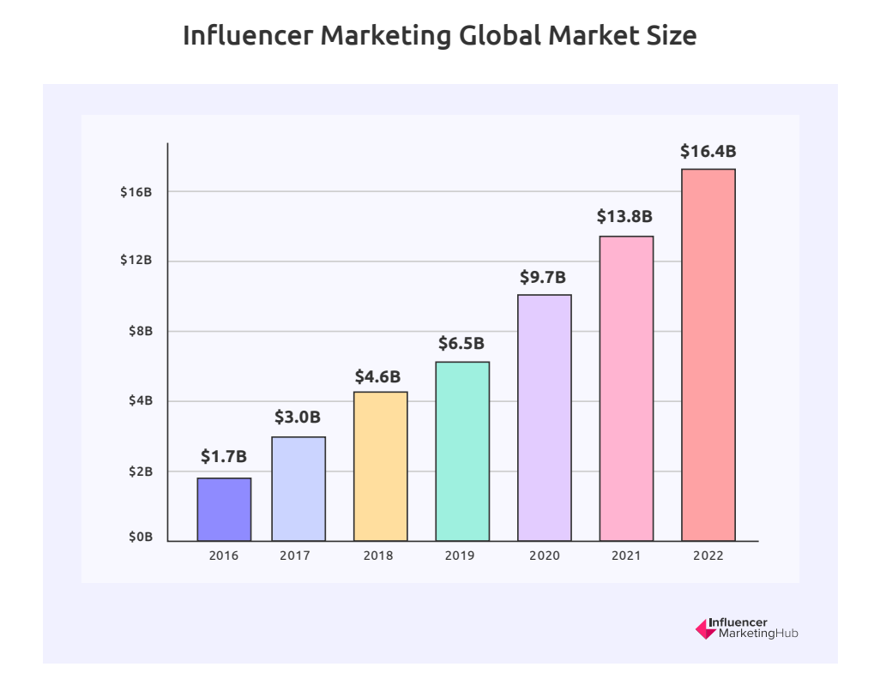
Global Growth in Use of Influencers

Slide 4
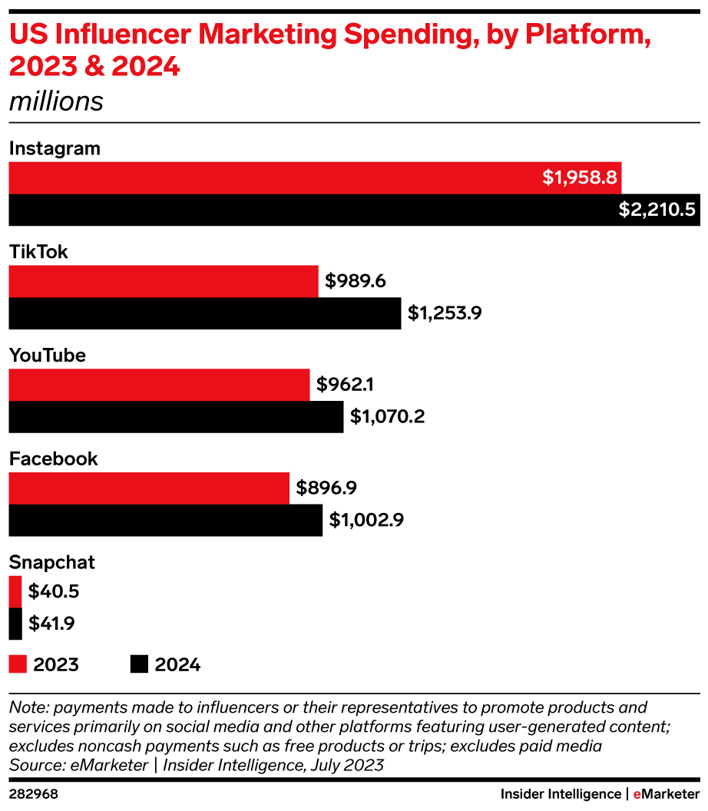
Widespread Use in the U.S.

Slide 5
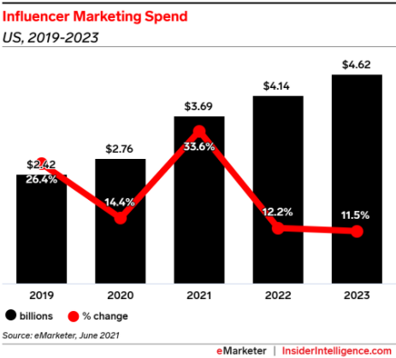
U.S. Influencer Marketing Spend

Slide 6
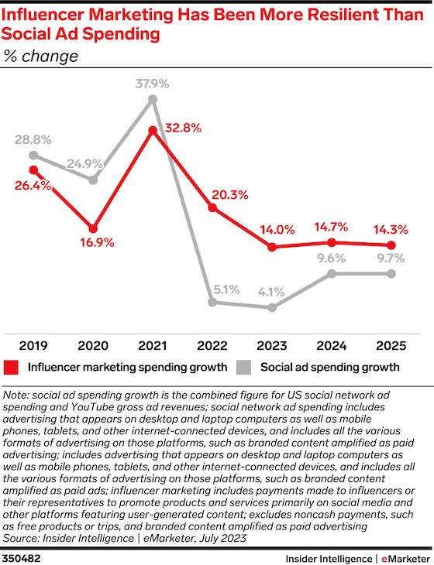
Influencer Marketing > Social Ads

Slide 7
Growth of TikTok

Slide 8
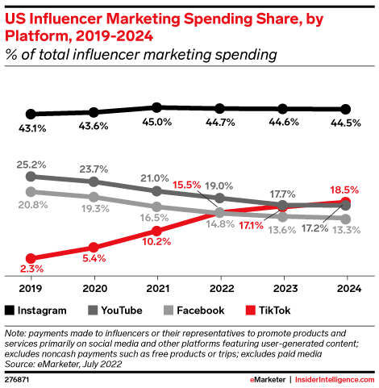
Instagram Dominates…but TikTok is on the Rise

Slide 9
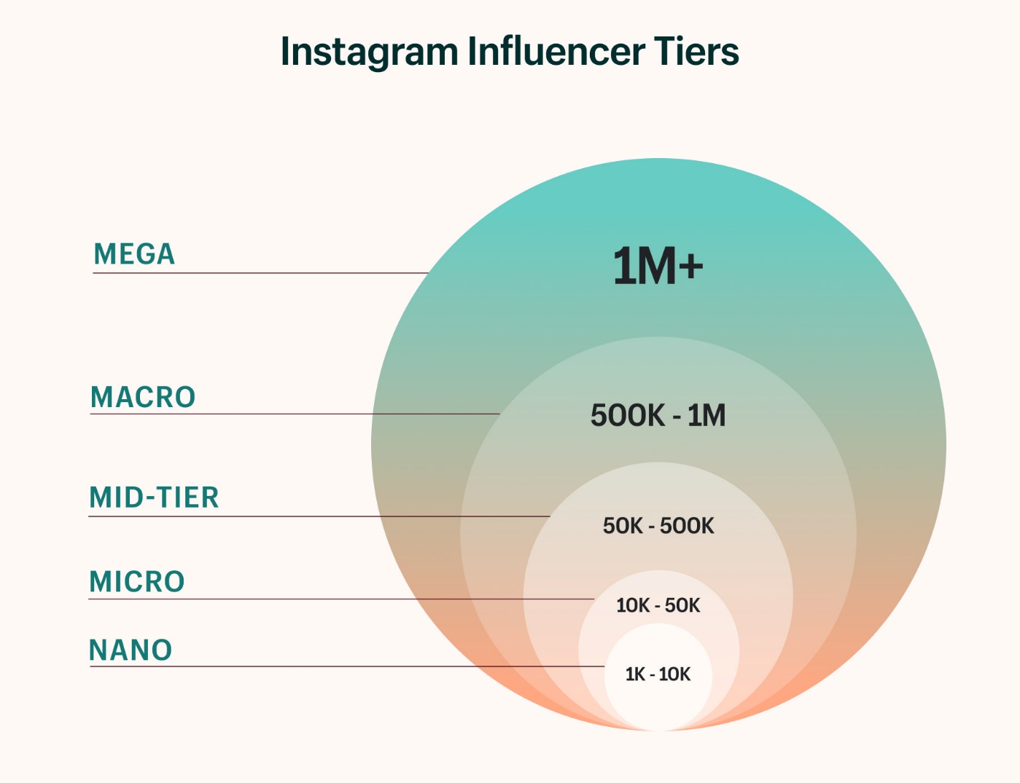
Tiers of Influencers

Slide 10
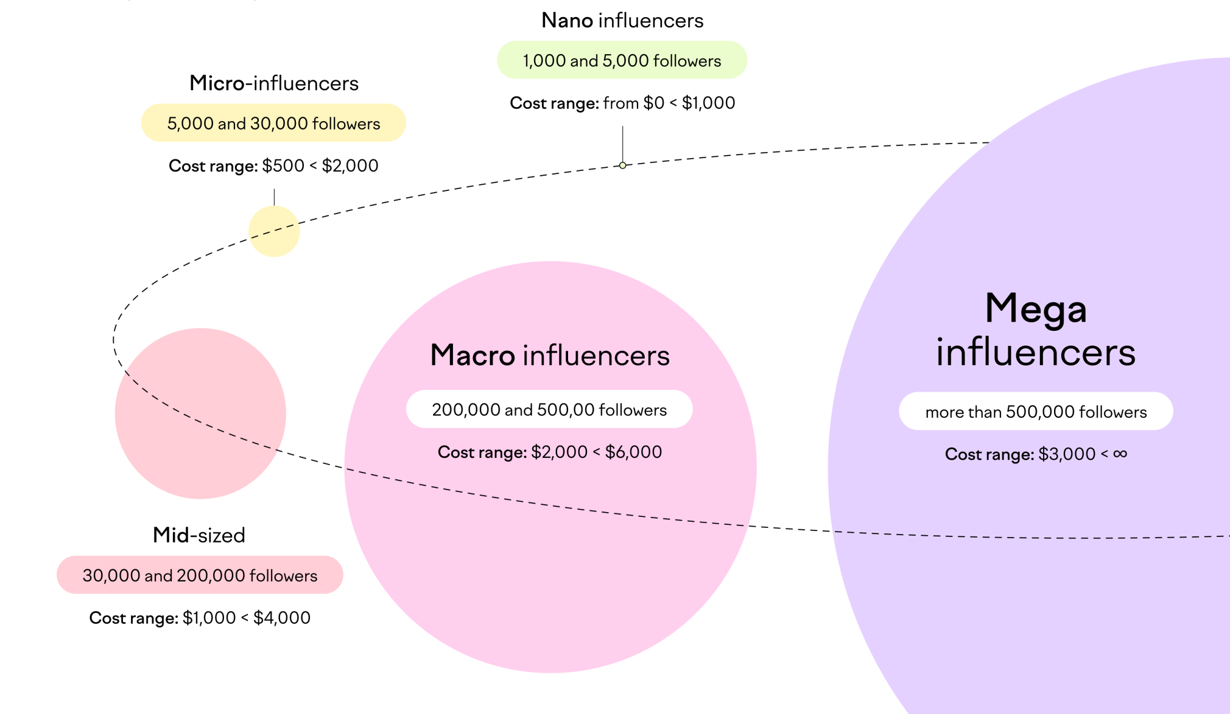
Influencer Costs by Tier

Slide 11
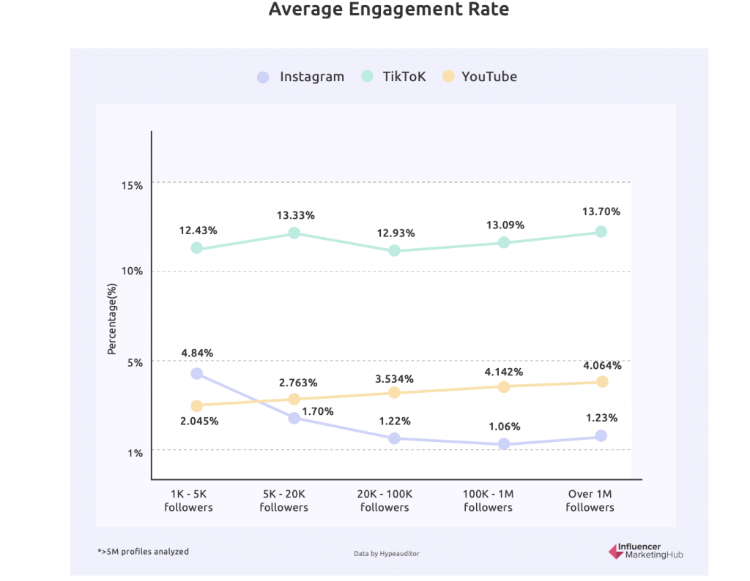
Effectiveness of Influencers

Slide 12
Influencers vs. Celebrity Ads
2020 study in the Netherlands
Compared to celebrities, consumers…
  Identify more with influencers
  Feel more similar to them
  Trust them more
Compared to a typical celebrity endorsement ad (famous athlete and a supermodel), well-known influencers (fitness blogger and beauty blogger) induced stronger brand attitudes and purchase intentions

Slide 13
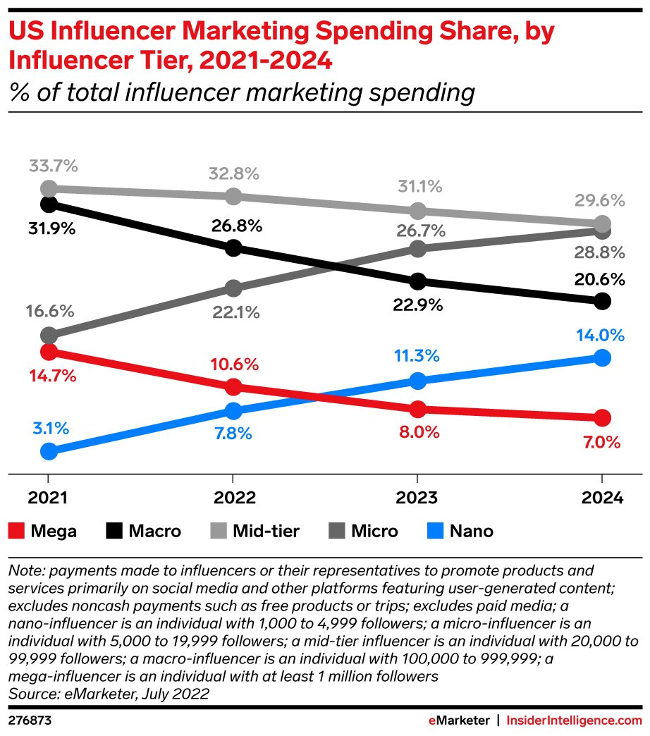
Trending toward Smaller Influencers

Slide 14
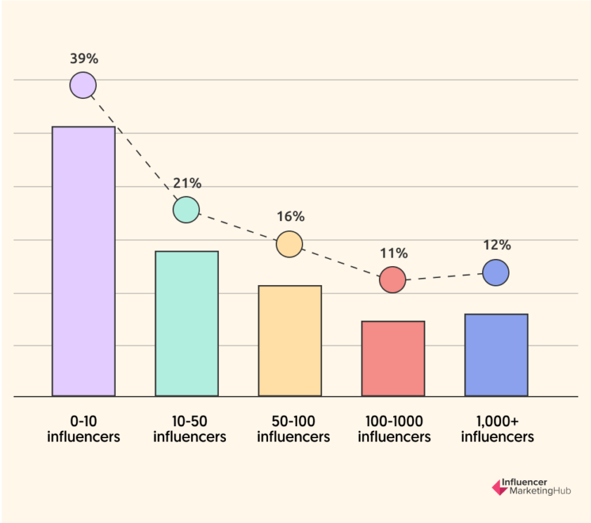
How Many Influencers?

Slide 15
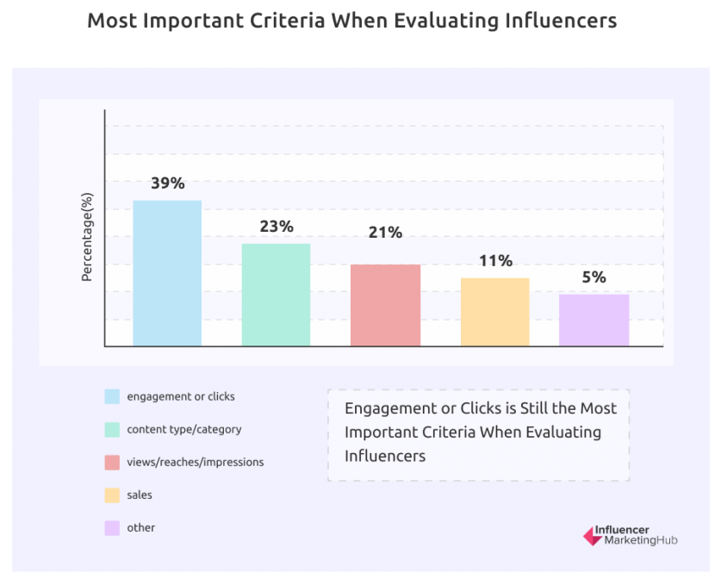
Selecting Influencers

Slide 16
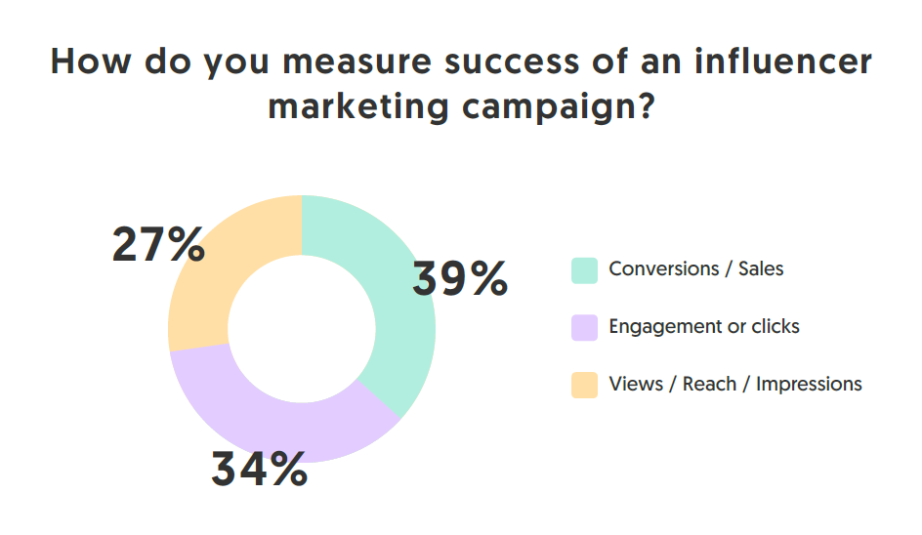
Measures of Success

Slide 17
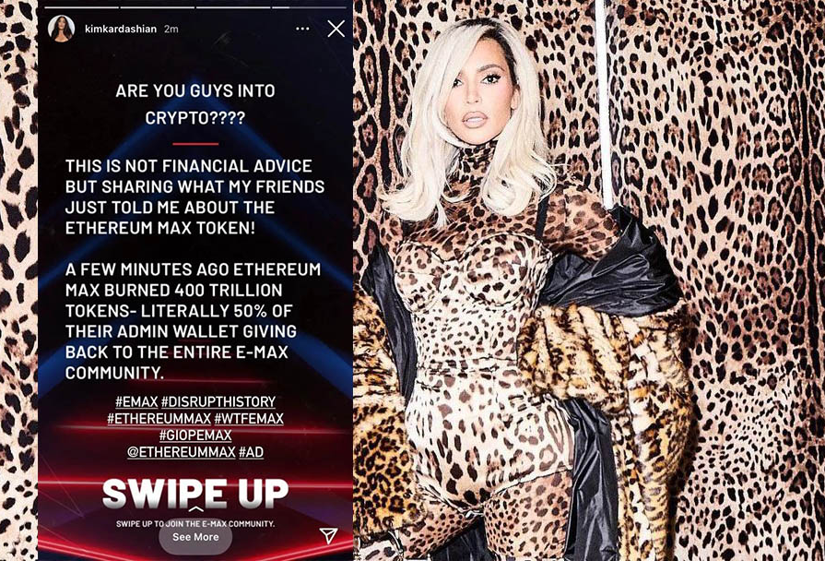
Drawbacks to Influencer Marketing
Legal compliance with regard to disclosure is low
Fraud (fake followers)
Lack of Authenticity
Over-use

Slide 18
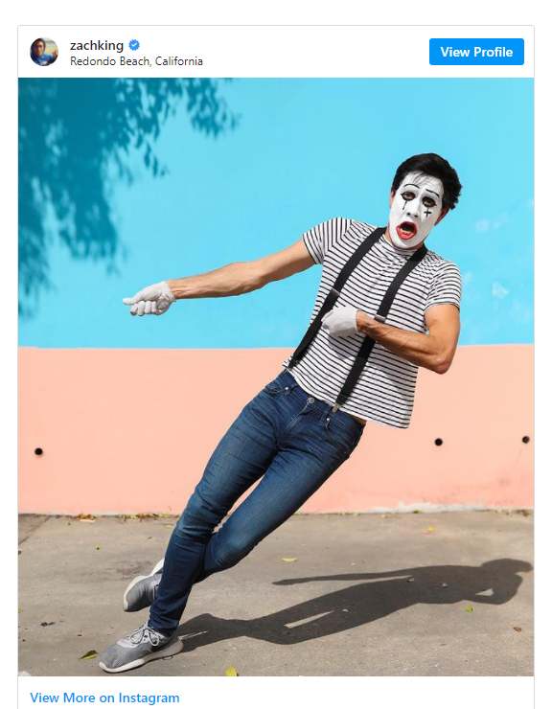
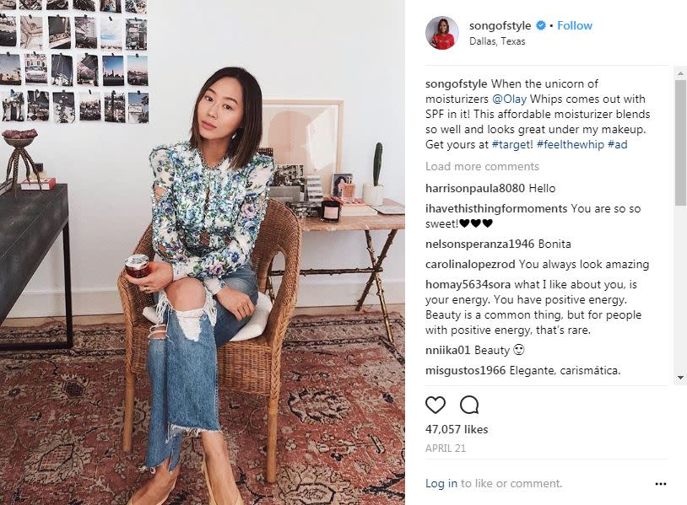
Influencers are Becoming Creators
Beyond simply endorsing brands
Creating entertaining content

Slide 19
Conclusion
Influencer Marketing is one of the hottest promotional tools
Does your company/brand use influencer marketing?
If so, what is its role in the promotional strategy/
How is it evaluated? Is it effective?

Slide 20
End of Lecture

